Slide 1
Support Vector Machine
Fatima Jahara
Senior Assessment Developer (Deep Learning and NLP), Workera.ai
Incoming Computer Science PhD student at Rutgers, The State University of New Jersey
Predoctoral Fellow 2023, Fatima Al-Fihri Predoctoral Fellowship
Former Alpha Tester at DeepLearning.ai

Slide 2
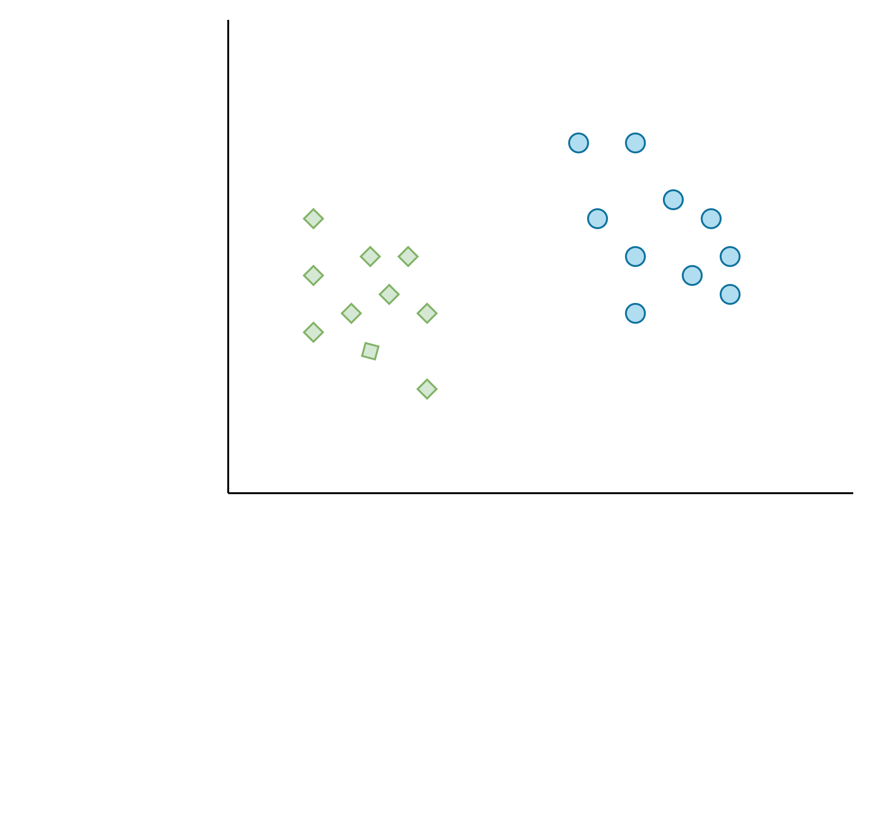
INTRODUCTION
An SVM is a supervised learning algorithm that helps classify data using a hyperplane.
Developed by Vladimir Vapnik and Alexey Chervonenkis in the 1960s.
What can be drawn to classify the green diamonds from the blue circles?
What is a Support Vector Machine (SVM)?
hyperplane

Slide 3

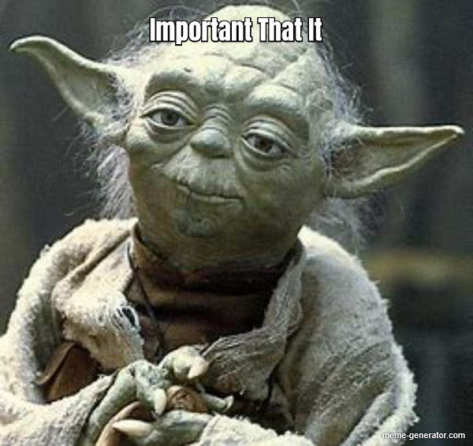

Why SVM?
Robust to outliers: SVM is able to handle outliers quite well.
Handles both linear and non-linear data: Great for classifying both linear and non-linear data.
Effective in High Dimensions: Works well even when data has many features.
Classification and Regression: Can be implemented for both classification and regression tasks.
Works with Small Datasets: Effective even with small amounts of data.

Slide 4
Basic Concepts

Slide 5
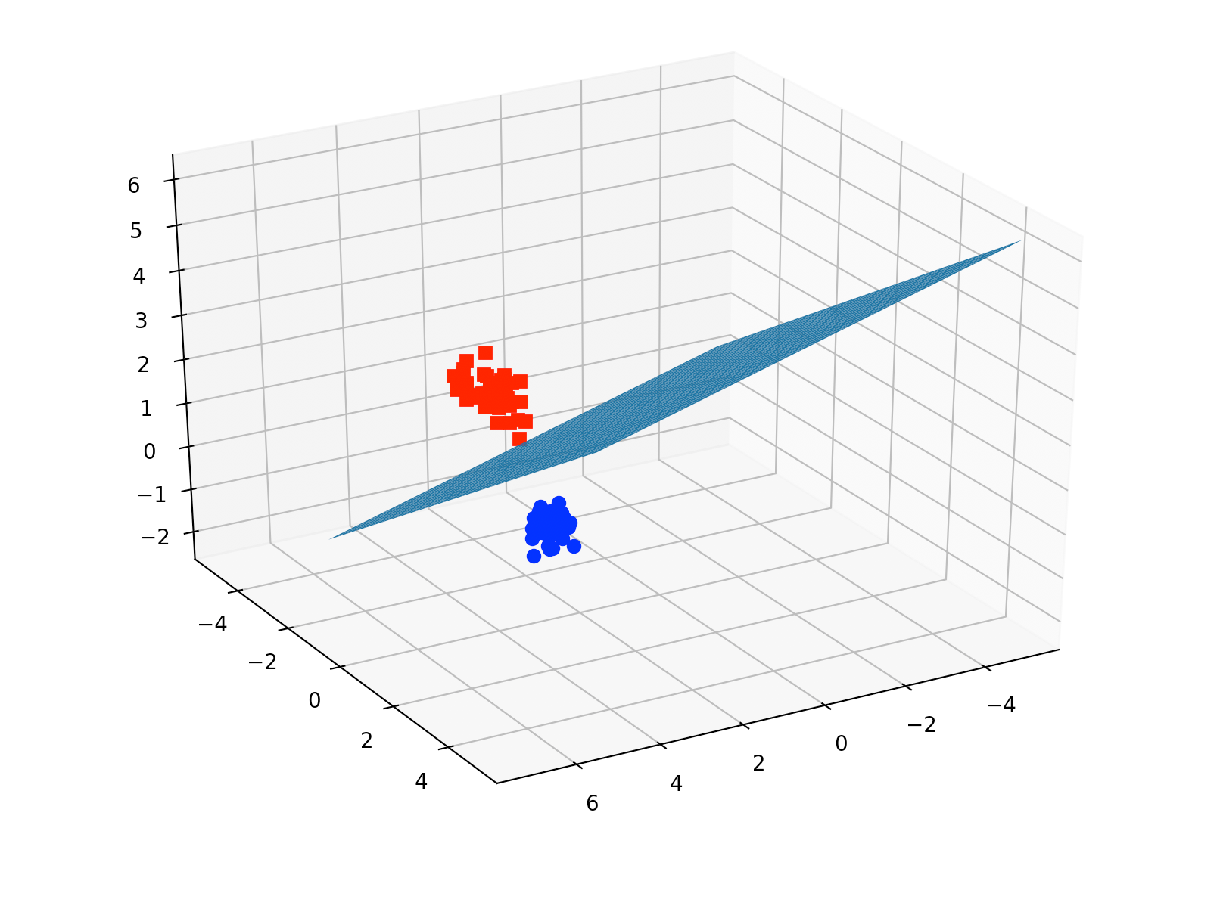
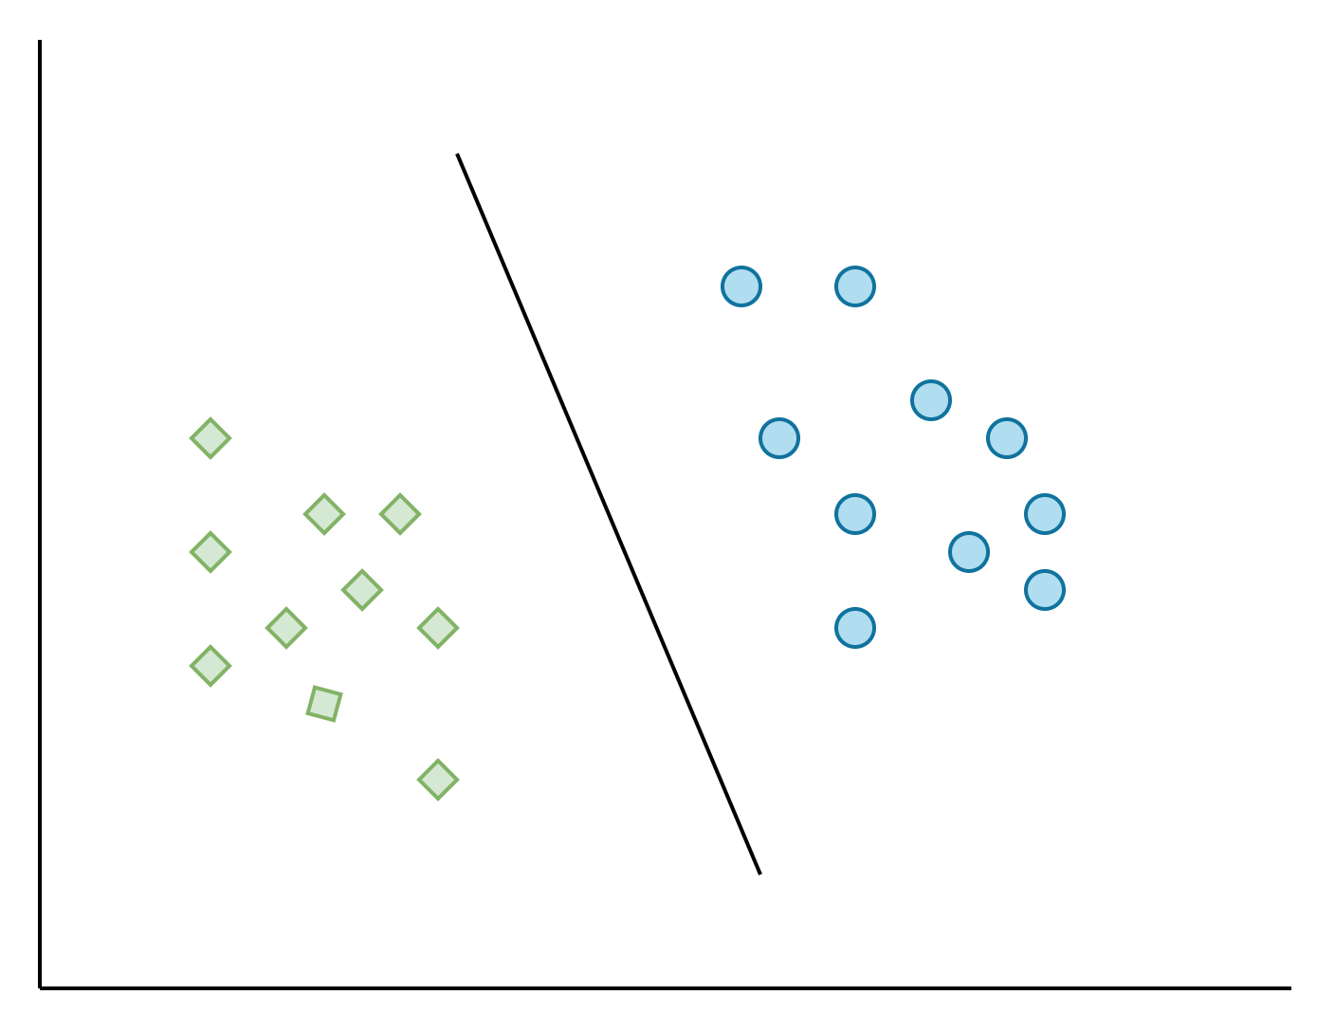
Hyperplane
A line (in 2D) or a plane (in 3D) that separates different classes in the data.
Also called decision boundary.
Purpose: To create a boundary that best divides the data into different categories.
hyperplane

Slide 6
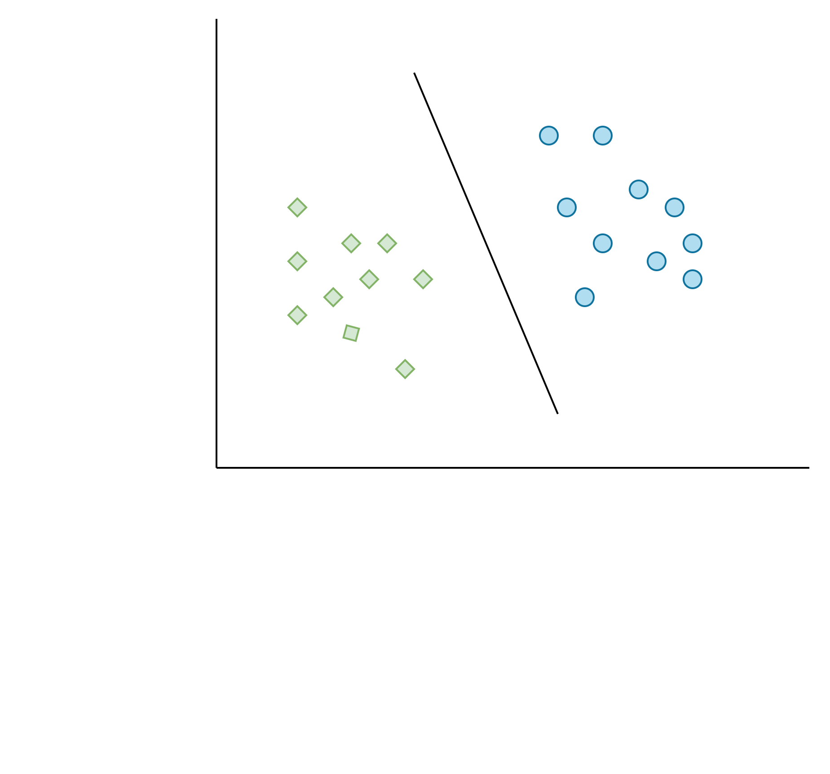
Support Vectors
Data points that are closest to the hyperplane.
Role: They decide where the hyperplane will be.
Importance: These points are crucial because they help maximize the margin between the classes.
Example: If you’re drawing a line to separate two groups, you want to make sure it’s as far from both groups as possible. The closest points help you find that perfect line.
Support vector

Slide 7
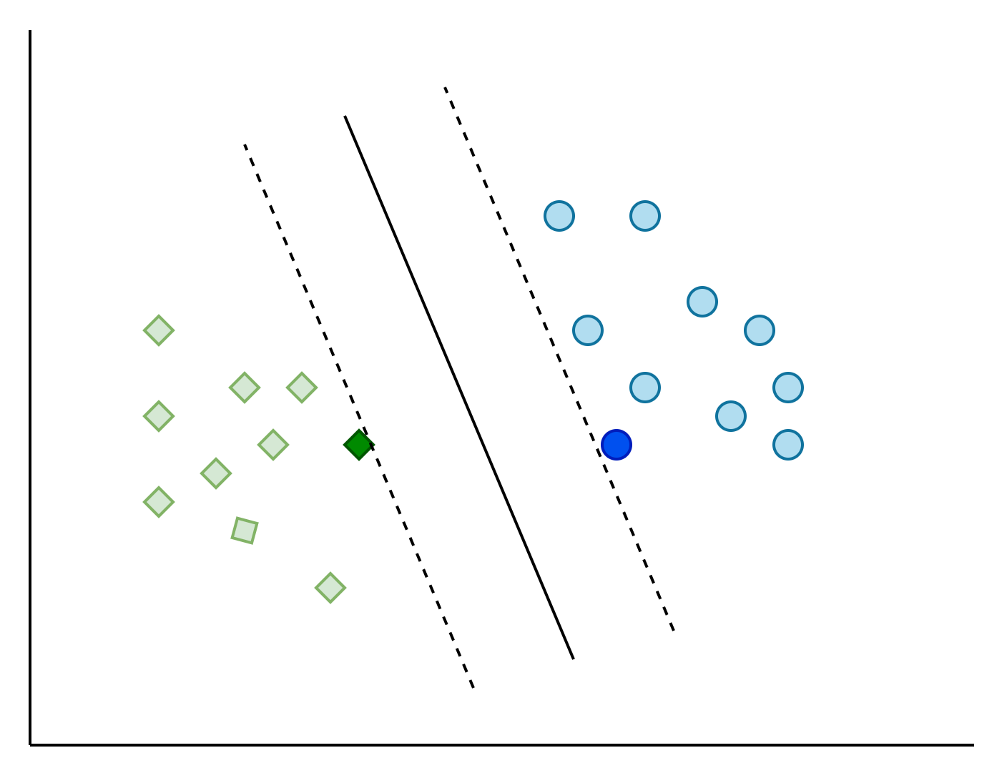
Margin
The distance between the hyperplane and the nearest data points from each class.
Purpose: To measure how well the hyperplane separates the classes.
Importance: A bigger margin means more space between the classes, making it easier to separate them correctly.
margin
SVM tries to maximize this margin. But why?

Slide 8
How does SVM work?

Slide 9
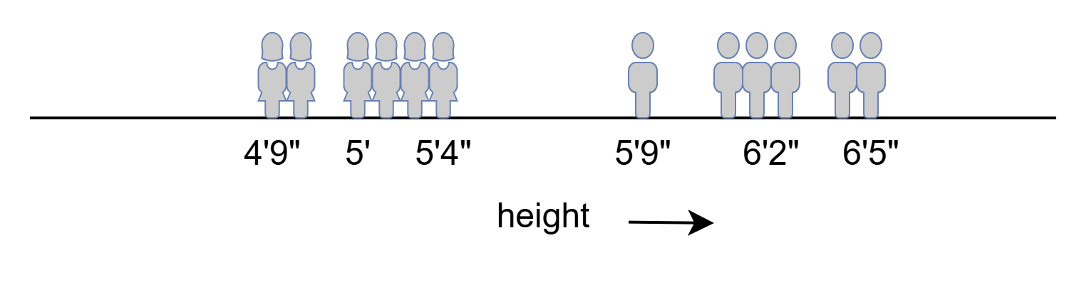
Classification with SVM: 1 Dimensional Data
We have a dataset containing 12 data points (students in a class). 6 of them are male and 6 of them are female. We are also provided their heights.
Now, we have a new student A whose height is 5’7”. We need to predict their gender.
But how do we do that using SVM?

Slide 10



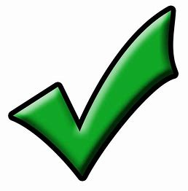

Classification with SVM: 1 Dimensional Data
First, find a point on the line that maximizes the distance from both classes.
The middle point (5’6.5”) seems to maximize the distance from both classes. Hence that’s our hyperplane.
hyperplane
5’6.5”

Slide 11
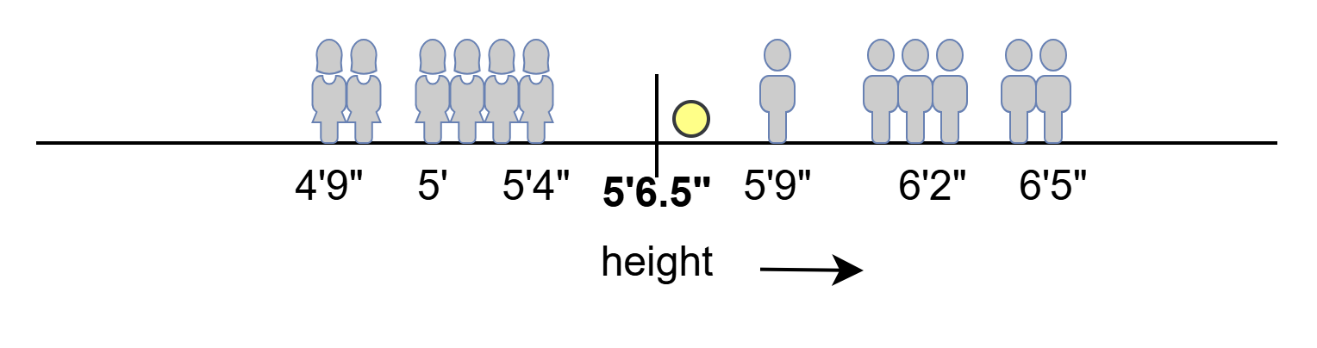
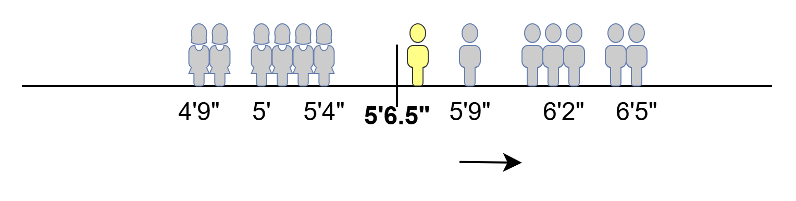
Classification with SVM: 1 Dimensional Data
Now let’s put our new data point (5’7”) and predict its class.
New student
5’7”
Based on the position of the data point we can say that it belongs to the MALE class.

Slide 12
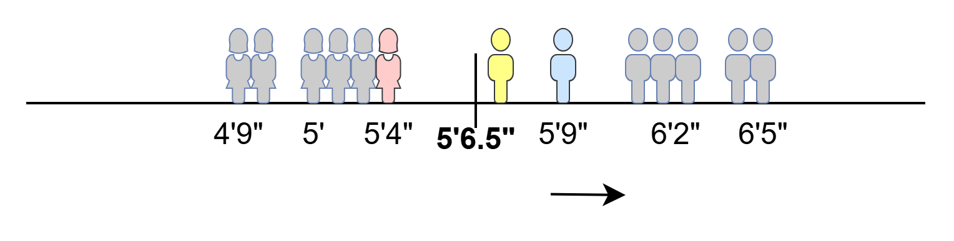
Classification with SVM
Any Questions?
Support vectors
margin

Slide 13
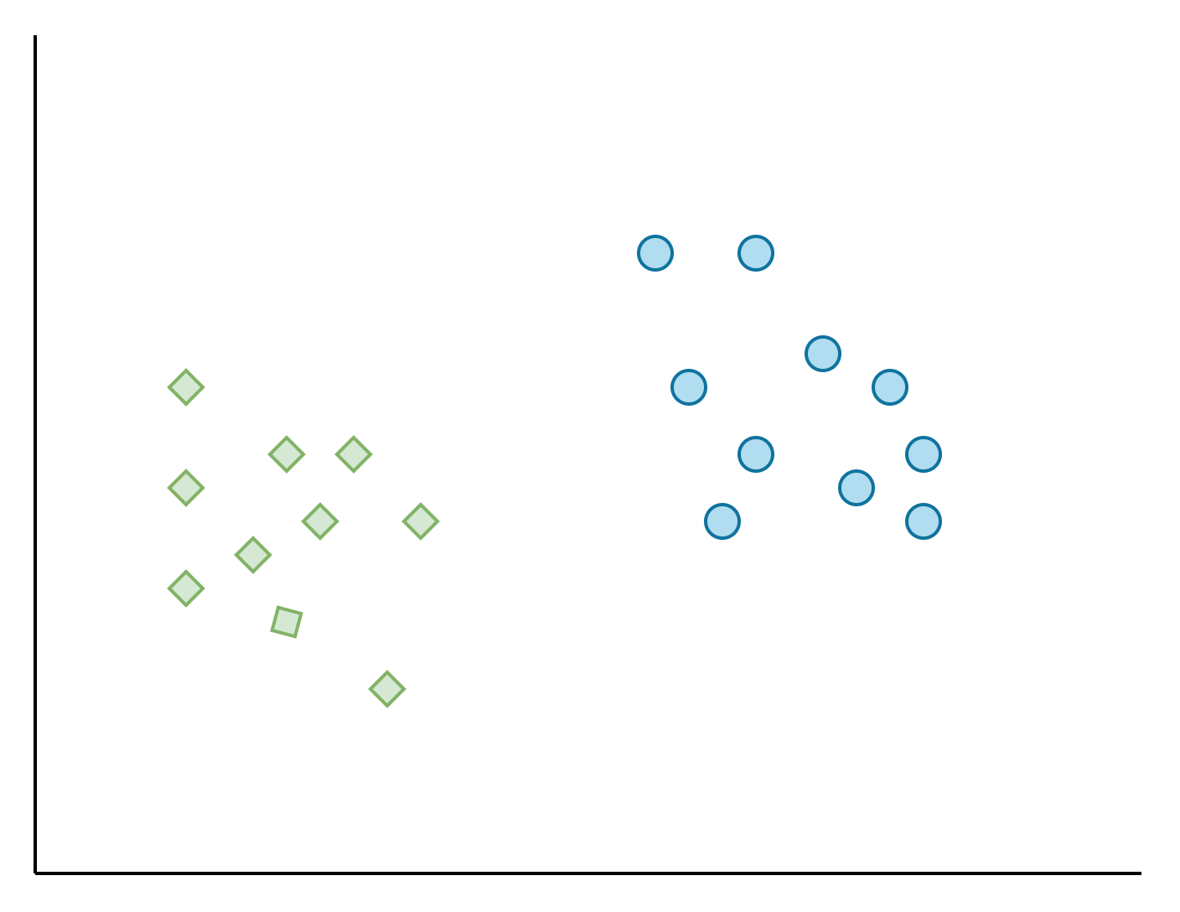


How does SVM work with 2 Dimensional Data
Step 1: Select a random hyperplane H1.
Step 2: Go in parallel to the hyperplane in the positive direction (suppose blue circle ) until you reach the first data point and then stop there. Suppose the positive hyperplane is named H1+.
Step 3: Similarly, go in parallel to the hyperplane H1 in the negative direction ( ) until you reach the first data point and then stop there. Suppose the negative hyperplane is named H1-.
Step 4: Now calculate the margin, d1, i.e., the shortest difference between H1+ and H1-.
H1-
H1
H1+
Margin (d)

Slide 14
How does SVM work with 2 Dimensional Data
Any Questions?
Step 5: Repeat step 1 to step 4 for several more hyperplanes (H1, H2, H3…).
Step 6: Now select the hyperplane (H) for which the value of margin (d) is the highest.
This is why the best hyperplane is called the Margin Maximizing Hyperplane.
H3
H1
H2

Slide 15
Types of SVM
Two types of SVMs based on Margin Type:
Hard Margin SVM
Soft Margin SVM
Two types of SVMs based on Linearity:
Linear SVM
Non-Linear SVM

Slide 16
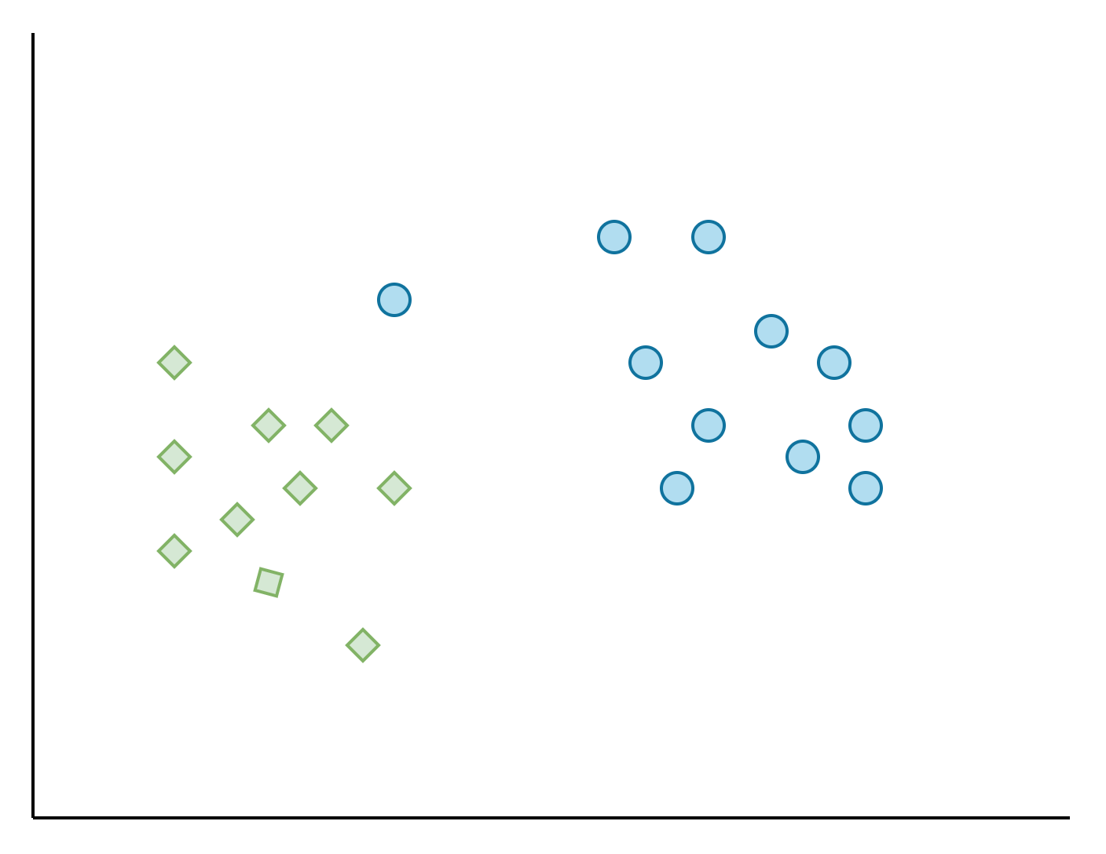
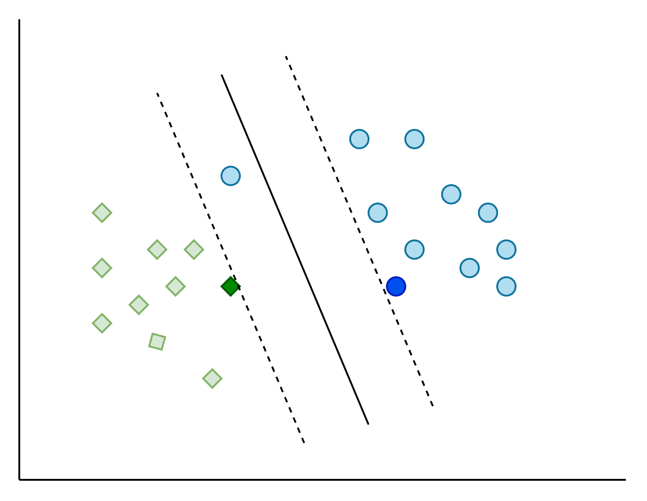
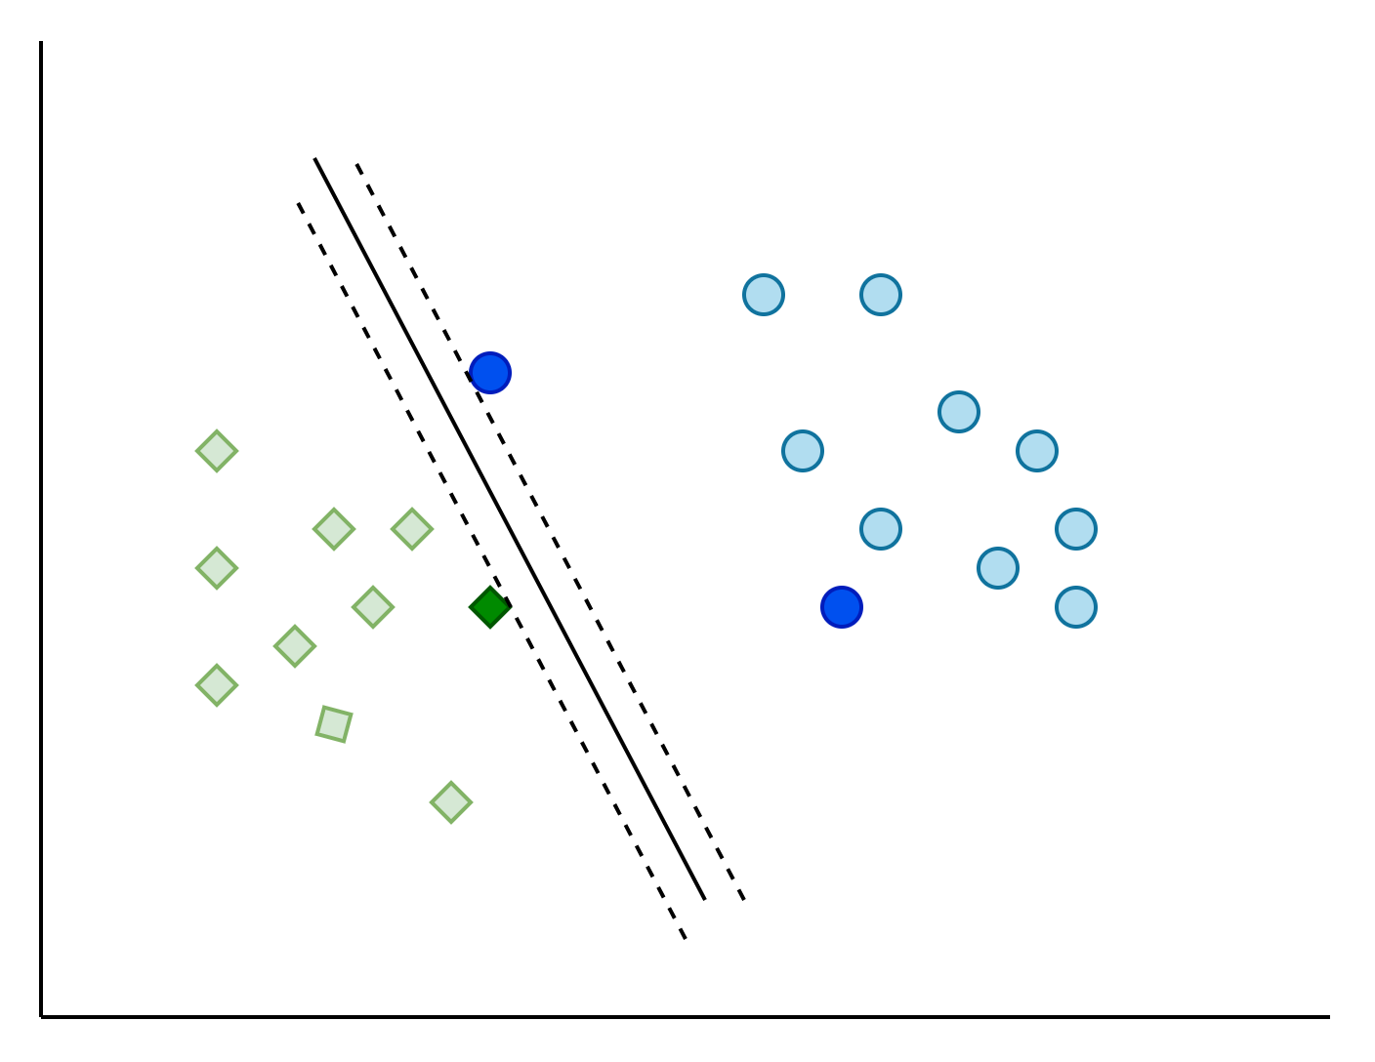
Hard Margin SVM vs Soft Margin SVM
New Datapoint
Our 2D dataset
2D dataset with new data point
Soft Margin SVM
Hard Margin SVM

Slide 17
Hard Margin SVM
Soft margin SVM
Aims to find a hyperplane that perfectly separates the classes without allowing any misclassifications.
Works well only if the data is linearly separable.
Allows some misclassifications to achieve a better overall model.
accommodates cases where data is not perfectly separable by balancing margin size and classification errors.

Slide 18
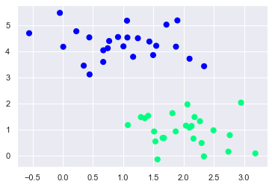
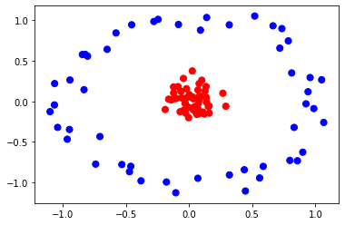
Linear SVM
Non-linear SVM
Uses a linear kernel to separate data with a straight line (in 2D) or a flat plane (in 3D).
Use Case: Best for data that can be separated with a straight line.
Example: Classifying emails as spam or not spam based on simple features.
Uses nonlinear kernels to separate data that isn't linearly separable.
Use Case: Suitable for complex datasets where classes are intertwined.
Example: Classifying images of different types of fruits.

Slide 19
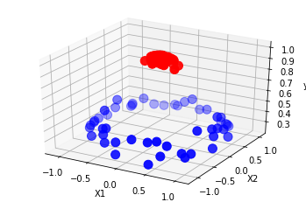
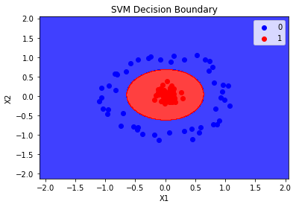
Non-Linear SVM using Kernel Trick
Kernels are a type of function that transforms the original data into a higher-dimensional space where it becomes linearly separable. This technique of classifying non-linear data using SVM is kernel trick.
hyperplane
2D non-linear data
3D linearly separable data
Classify the data in 3D using a plane (hyperplane)
Transforming back the 3D separated data into 2D.

Slide 20


Slide 21
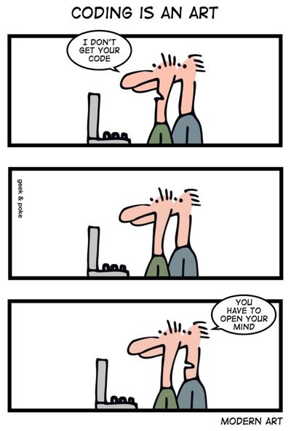

LET’S CODE

